Slide 2
How do we bring together data, AI, decision makers, and the community to learn how to make our cities better*?
* safer, more efficient, sustainable, optimally utilised

Slide 3
UrbIA: Urban Insights Atlas
Brings together urban planning experts / policy makers, data, AI, the Digital Atlas, and the community to collect place-based insights for improving urban mobility
Utilizes retrieval-augmented generation (RAG) to convert data into insights that will be crowd-reviewed

Slide 4
UrbIA: Urban Insights Atlas
Interactive Map: Users navigate a map to access local data about their city.
Data and AI: As users navigate, the app pulls in various data points and uses AI to create easy-to-understand insights.
Community Feedback: Users can react to these insights by upvoting, downvoting, and sharing their thoughts, helping to improve the recommendations.

Slide 5
UrbIA: Urban Insights Atlas
Insight Categories
Safety Insights
Capacity Forecast Insights
Sustainability/Mobility Insights
Public Utilisation Insights

Slide 6
UrbIA: Urban Insights Atlas
Safety Insights using Open Road Crash data

Slide 7
UrbIA: Urban Insights Atlas
Capacity Forecast Insights using Traffic Volume data

Slide 8
UrbIA: Urban Insights Atlas
Sustainability/Mobility Insights using Train Service Passenger Counts

Slide 9
UrbIA: Urban Insights Atlas
Public Utilisation Insights using Park PIR Counters

Slide 10
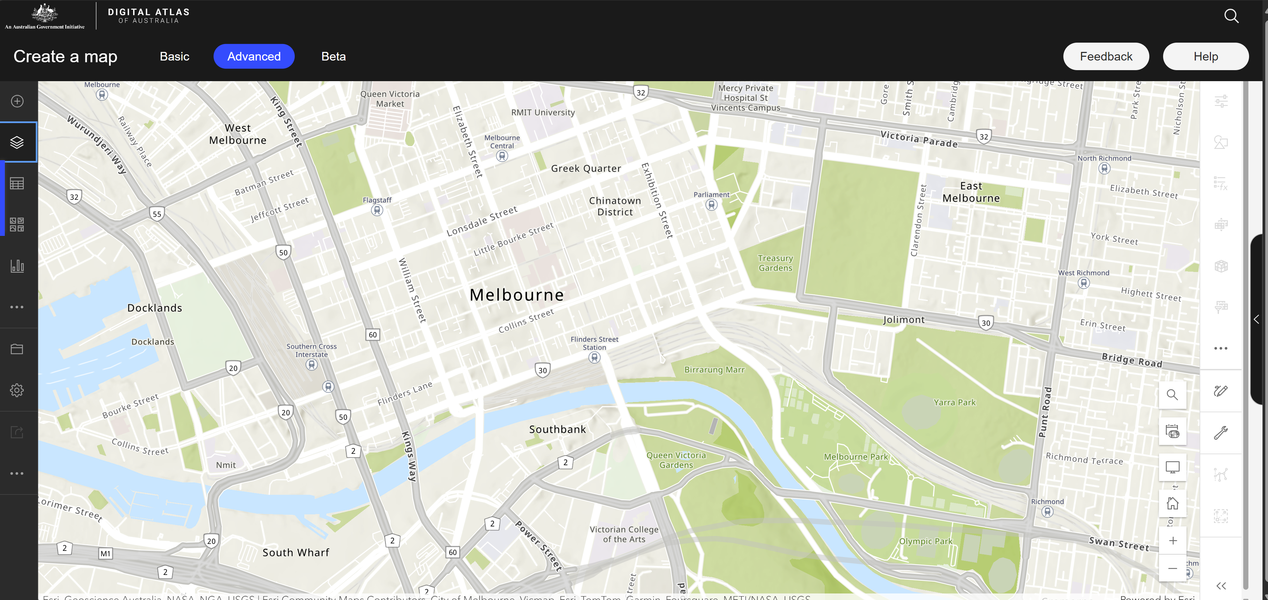
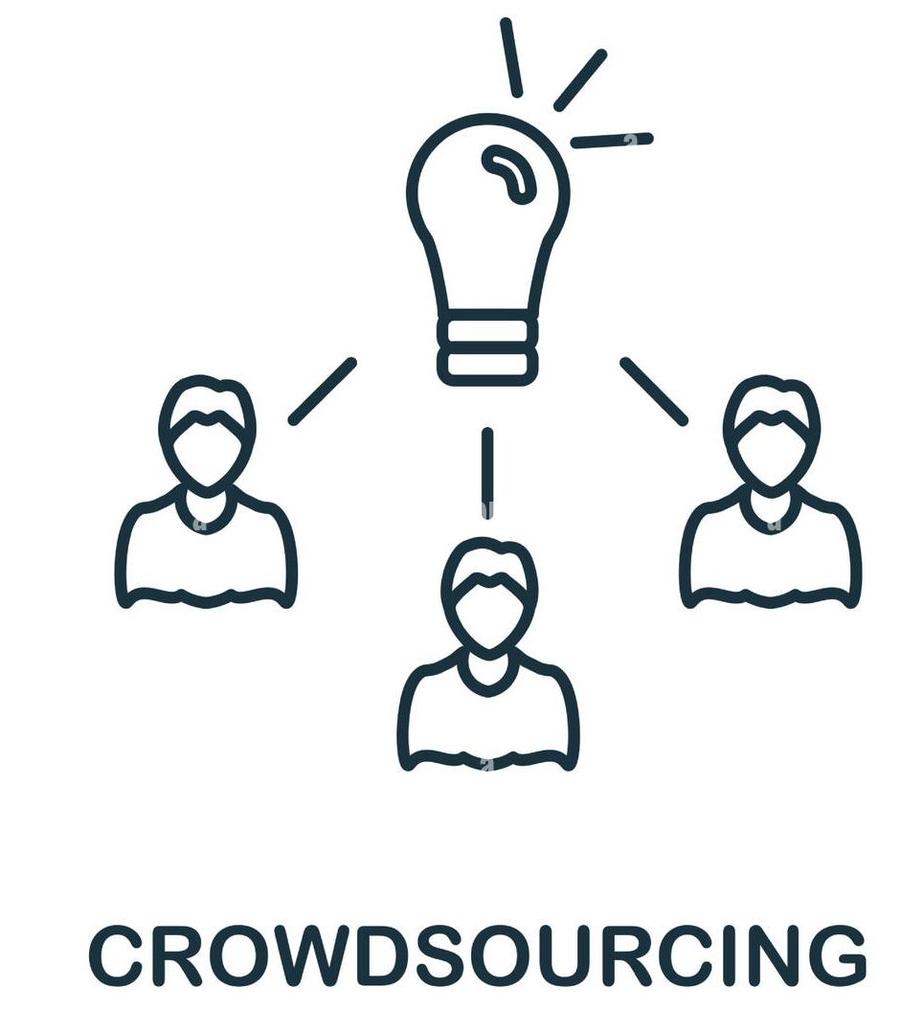

UrbIA: Urban Insights Atlas
Localised Data
Open Road Crash Data
Traffic Volume Data
Train Service Passenger Counts
Park PIR Counters
[etc]
Safety Insights
Capacity Forecast Insights
Sustainability/Mobility Insights
Public Utilisation Insights
Approval/Disapproval
Feedback
Additional Insights

